Slide 1


Basic Legal Citation Presentation 3
Presented By
Yihui Fu
Akshay Tata
Aiswarya Jami
Notes:
Good morning, I’m here to present our project Basic Legal Citation for the course CS 5150, with Akshay and Aiswarya

Slide 2
The Team
Aiswarya Jami aj493
Akshay Tata at758
Brenda Olivia Martis bom6
Devi Snigdha Muppala dm754
Harish SethuMadhavan hs643
Joao Curcio jfc293
Sania Nagpal sn579
Yihui Fu yf263
Notes:
First, please allow me to introduce the team.

Slide 3
Outline
Recap
Progress
Project Summary
Notes:
We will start the presentation by recapping the second presentation, then show the progress achieved in 3rd iteration, and wrap up the presentation with an overall project summary.

Slide 4

Recap
Project Overview
Current Website
Requirements
Iteration I - Tasks and Testing
Iteration II - Tasks
Notes:
This is an overview of the topics we’ll be presenting today. The main objectives of this presentation are
To introduce the project once again
Show the progress by explaining what we have done so far
Mention what is to be done.

Slide 5
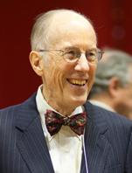
The client
Prof. Peter W. Martin
The Co-founder of Cornell's Legal Information Institute (LII)
The Jane M.G. Foster Professor of Law, Emeritus
Former dean of Cornell Law School
Notes:
And that’s him! In addition to these, he is the author of the book Basic Legal Citation, on which our project is based.

Slide 6

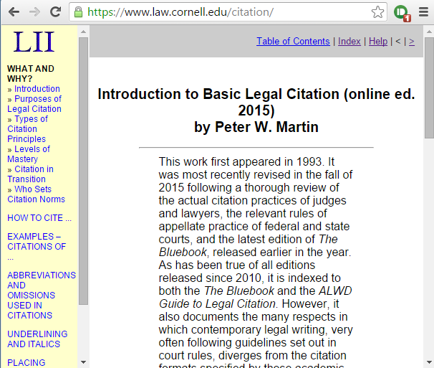
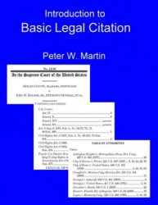


Basic Legal Citation
Notes:
The book is also available in other downloadable formats such as PDF, ePUB and mobi.
Each of these four formats have their own updating process, which means if there is a change in the book, the content has to be modified 4 different times before releasing a new edition. And this process was done manually by the author!

Slide 7
Current Website
Live Demo
Notes:
Suppose I am a first year law student and I have an assignment where I have to cite a case from the CA court to be presented in a Texas court. I don’t know how to do it. I will go to the legal citation website look up the ways to cite based on the category. Has to be done state wise, or based on the category
The website provides different pages through which a citation can be learned.

Slide 8
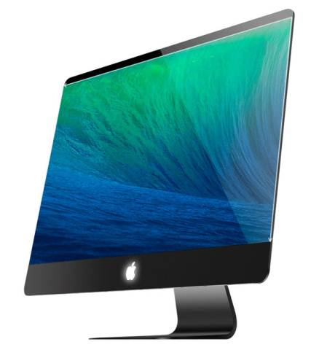
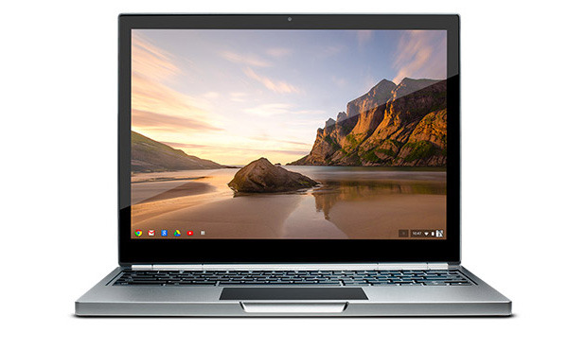
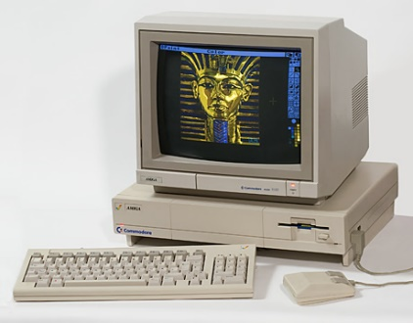
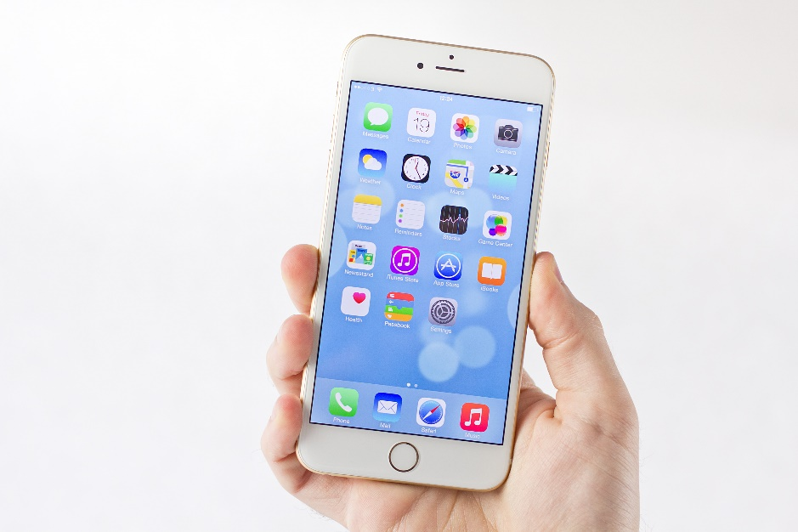
Requirements - Modernize website
Notes:
Work in 1993. Website in 1994. […]

Slide 9
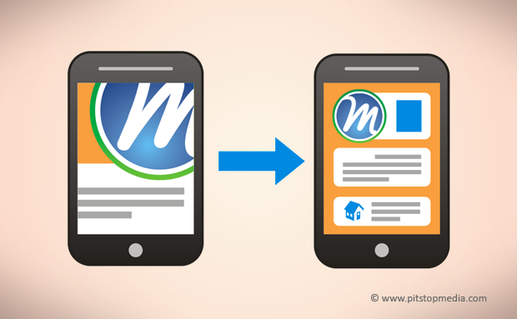
Requirements - Mobile Friendly
Notes:
Websites which are not written for mobile devices

Slide 10
Requirements - Easy Conversion to all formats
Original HTML
HTML5
EPUB
PDF
MOBI
Notes:
Till now the author manually changes the content in all formats to maintain consistency
To allow easy conversion to all formats we did:
We converted the original HTML file into HTML5.
We also added our own tags which will help us for easier conversion to all formats.
Single source document that can be edited and delivered in all the formats.
Arms: technical difficultys. Are you going to talk about it?
XHTML is replaced by HTML5
Currently it is still XHTML. We’re exploring if it can be done easily through HTML5.
But conversions might be a problem if HTML5 is used.

Slide 11
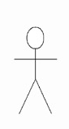


Workflow
Uses
Publish
HTML
Author
View/Download
Visitor
Notes:
The author uses a web development tool called dreamweaver to edit and modify the website.
He later publishes the html content to AWS.
The visitor(who is a law student or anyone interested in learning how to cite) can now view the website and also download content.

Slide 12
Iteration I
Website
Mobile friendly and more interactive
Removed iFrames and added expand-collapse panels for examples of citations.
Conversion to PDF, ePub through Calibre.
Content files separated from the design skin of website => Easily-convertible
Notes:
for the 1st iteration, we primarily focused on two parts.
1st is the website.
We have redesigned the entire layout and the look of the system.
We also made the site mobile friendly, to make it work for smaller screens when viewed on mobile device.
We also made it more interactive.
Removed iFrames and added expand collapse panels for citations.
2nd component: to make the conversion to other formats easy, we separated the file contents from the design. This made the conversion easy.

Slide 13
Iteration I - Demo
Notes:
This maybe replaced by <tag-data> type of tags, if HTML5 is used.

Slide 14
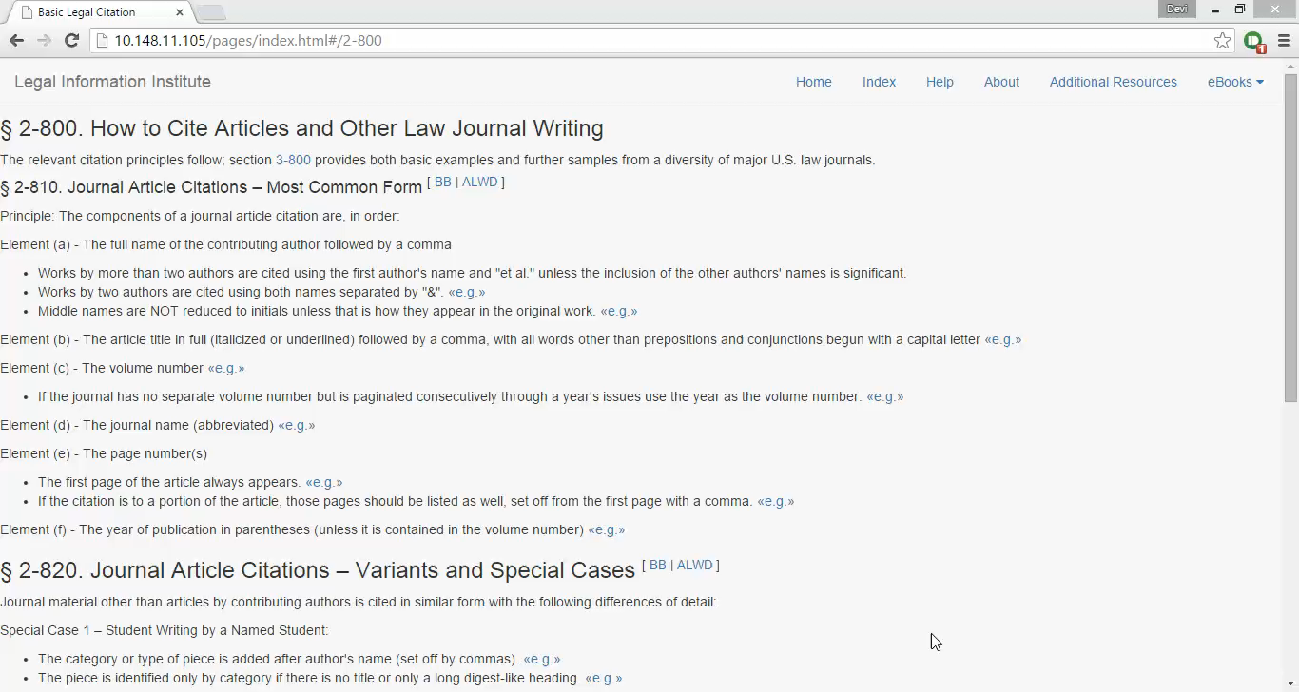

Slide 15
Testing I
Pop-up menus rather than Expanding and collapsing the text.
<<e.g.>> should appear as a button
Background colors in the pop-up for a stronger color.
Inputs from Sylvia on markup tags.
Notes:
We conducted user testing with a Cornell law school student, and collected the feedback.

Slide 16
Iteration II
Expand-Collapse Panels replaced by Pop-up windows.
HTML Markup tags added to some files.
Search implemented for the list of States table.

Slide 17
Iteration II - Demo
Notes:
This maybe replaced by <tag-data> type of tags, if HTML5 is used.

Slide 18
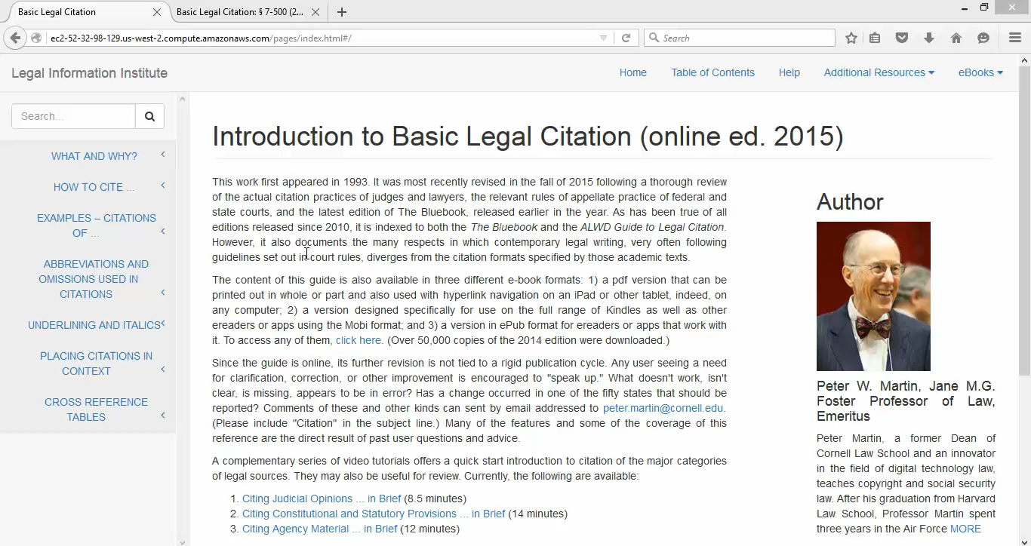

Slide 19
User Testing - Methodology
Participants: the client, and a law student
No prior demonstration/training
Asked to evaluate the features
Feedback was collected through emails
Notes:
When talking about testing, we can mention that a part of our team acted as testers too apart from the two people mentioned on the slide.

Slide 20
User Testing II
From the law student
Highlight selected tab on navigation pane.
Different font-types.
Different color and organization schemes.

Slide 21
Client Testing II
From the client
More information about the client in author section
Initial example text-box
Font size adaptable to the browser settings
Text styling
Notes:
Only considered the 1st point as this was useful. We can show the before and after screenshot for this.
Text styling -> examples text left aligned whereas the rest of website should be justified

Slide 22
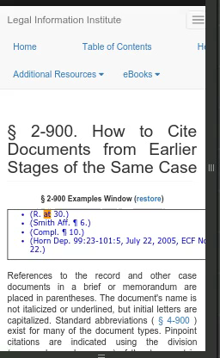
Client suggestions : revisited
Notes:
Only considered the 1st point as this was useful. We can show the before and after screenshot for this.
Text styling -> examples text left aligned whereas the rest of website should be justified

Slide 23

Progress
Iteration III - Tasks
Demo of the website
Iteration III - Testing

Slide 24
Iteration III
Website
AngularJS iframes for Initial example text-box
Selected tab highlighted on navigation pane
States’ table implemented with effective search bar
Parser script to reflect above changes in all files

Slide 25
Iteration III (cont.)
Conversion
Remove iFrames
Web Pages
Pdf
ePub
“Ignore” class
Linearization of tables
CSS Styling
Notes:
Linearization was required because the original tables were too big to fit in epub or pdf formats

Slide 26
Iteration III (cont.)
Documentation
HTML5 tags – definition and usage
Locate example files
Layout changes in the website design
Notes:
Linearization was required because the original tables were too big to fit in epub or pdf formats

Slide 27
Iteration III (cont.)
Author View
Author authentication
Click button to convert web pages to pdf or epub

Slide 28
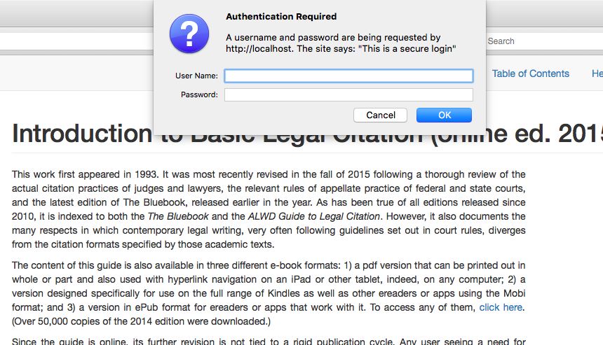
Author view

Slide 29
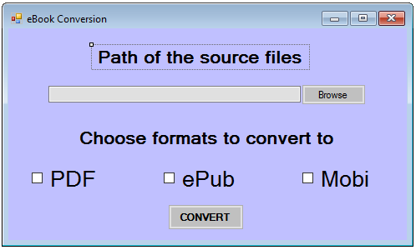
Author view (cont.)

Slide 30
Demo of the Website
Live Demo

Slide 31
Current website on Mobile
CSS for different screen sizes:
Supports major screen sizes like iPad, iPhone, Samsung Galaxy
Not conducted on real mobile devices but on simulator
Notes:
Linearization was required because the original tables were too big to fit in epub or pdf formats

Slide 32
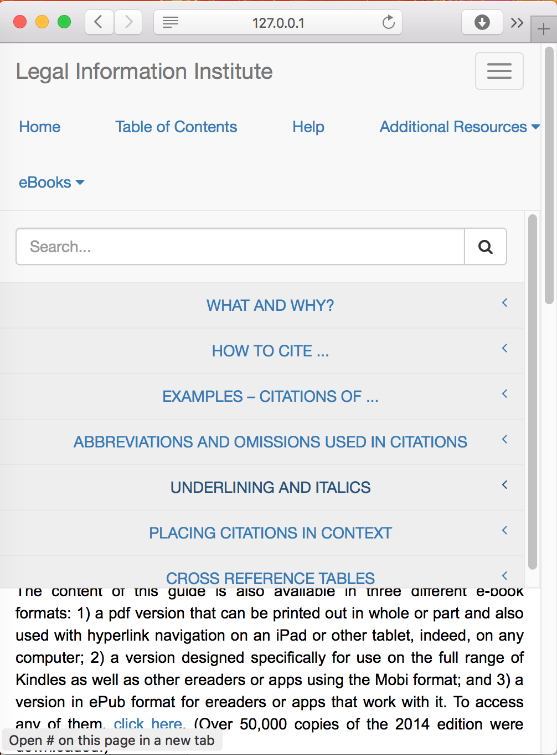
Demo on small screen

Slide 33
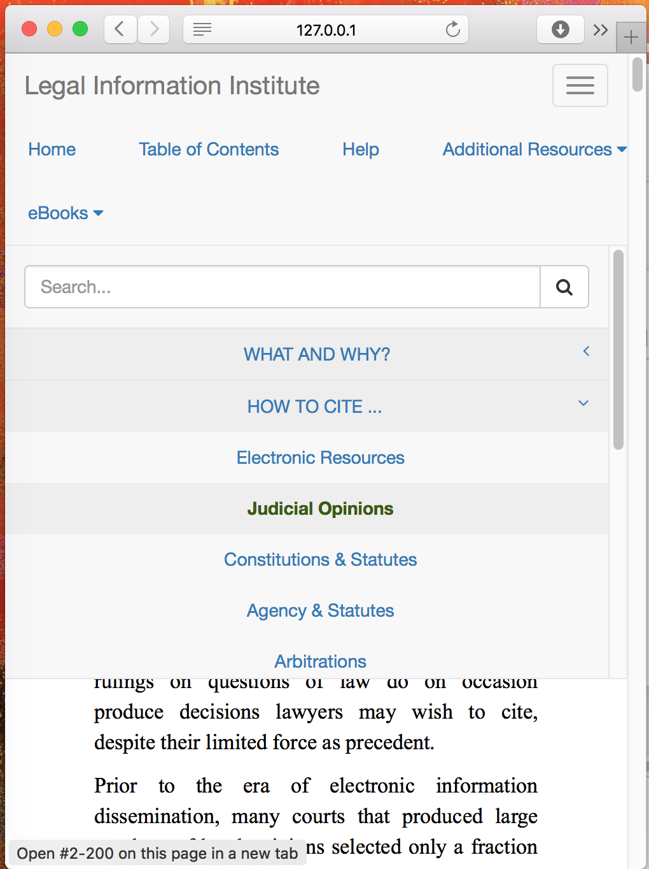
Demo on small screen

Slide 34
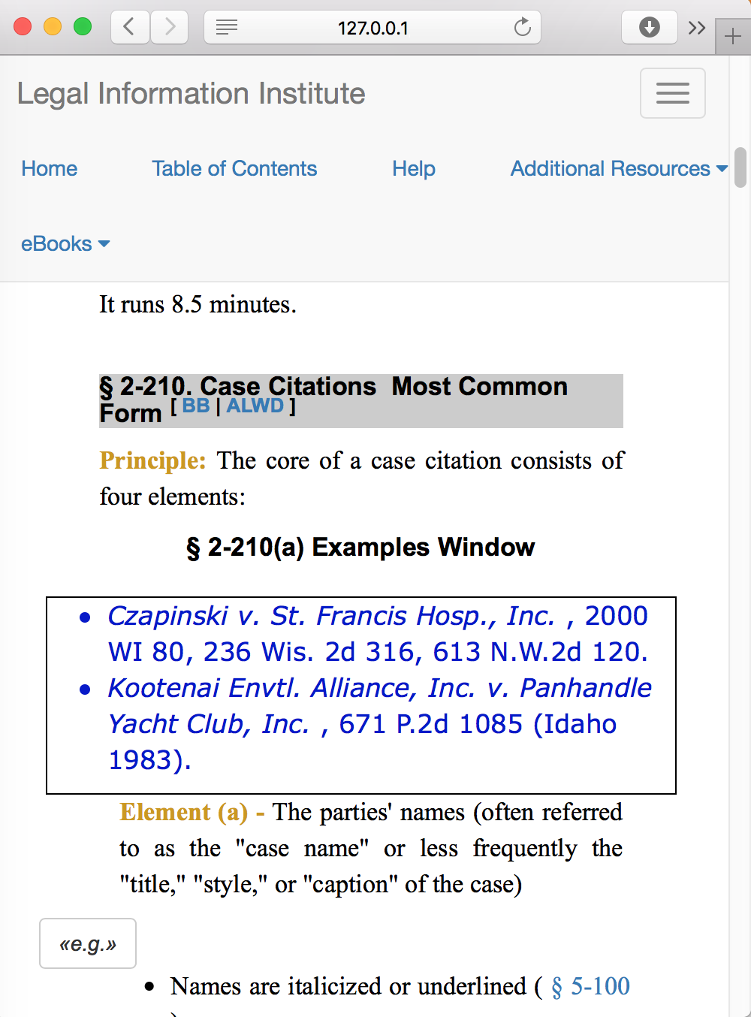
Demo on small screen

Slide 35
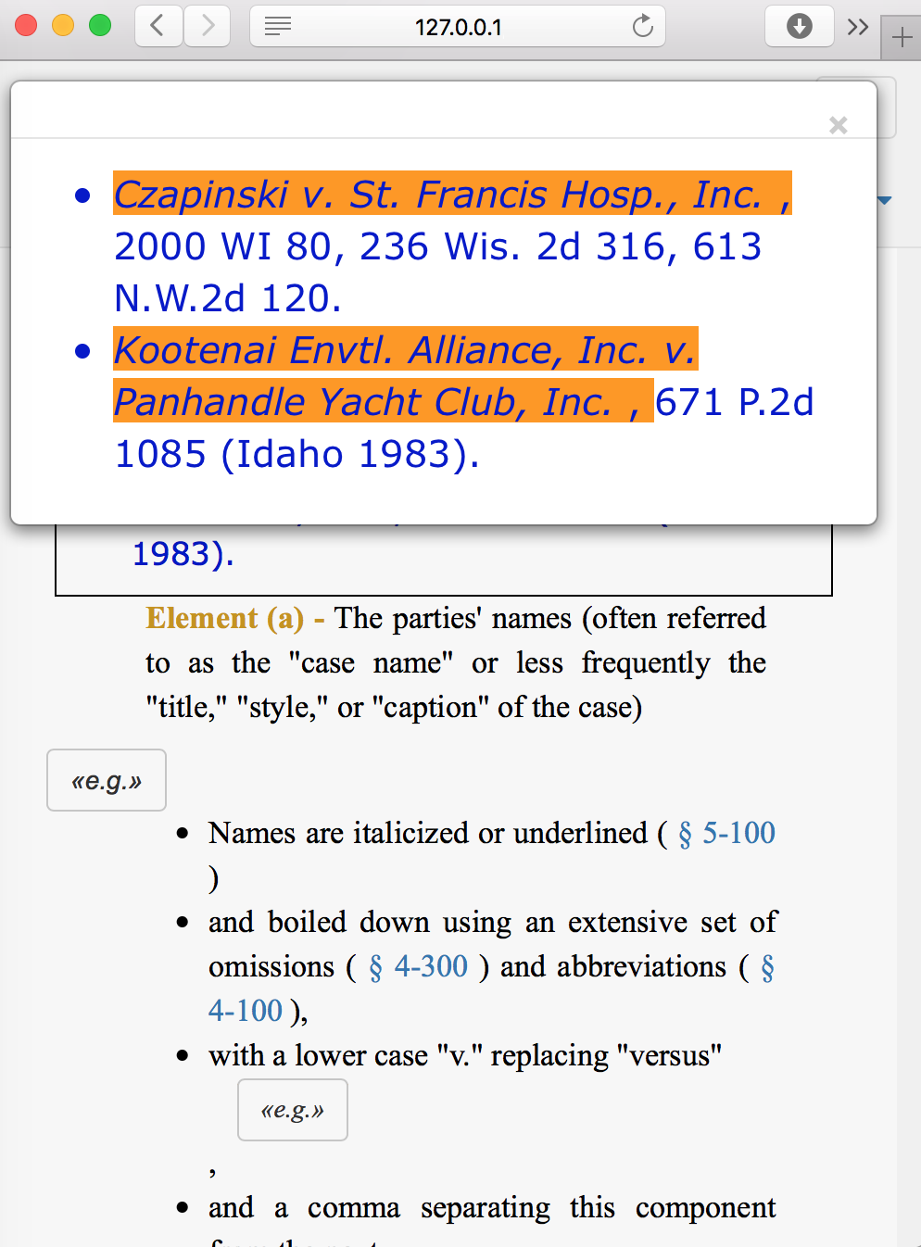
Demo on small screen

Slide 36
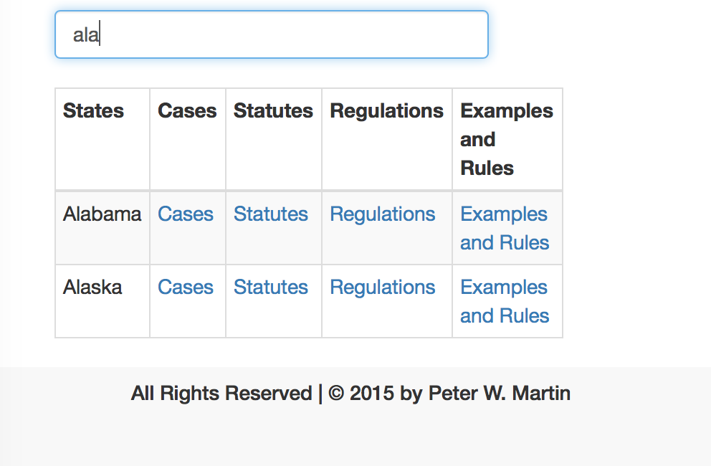
Demo on small screen

Slide 37
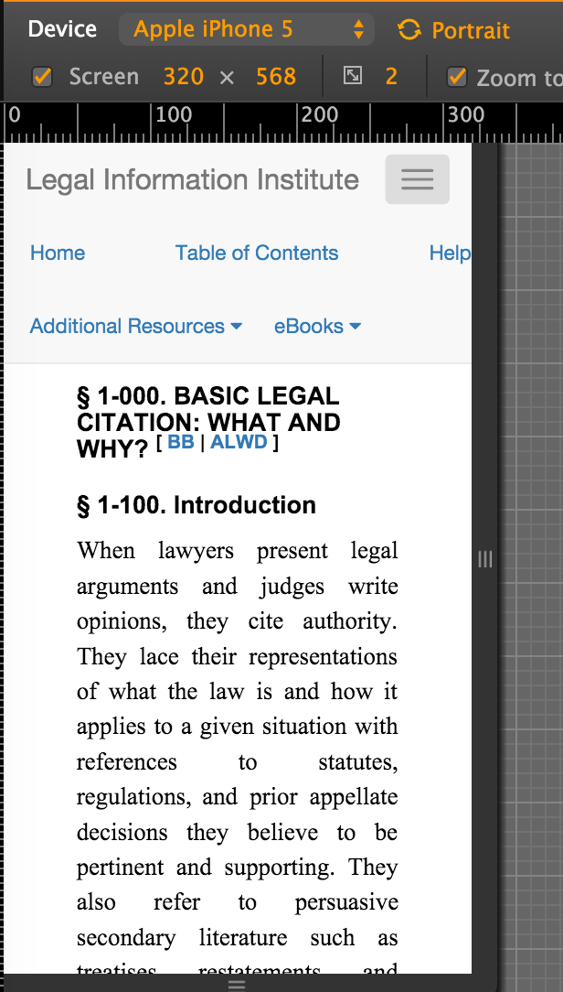
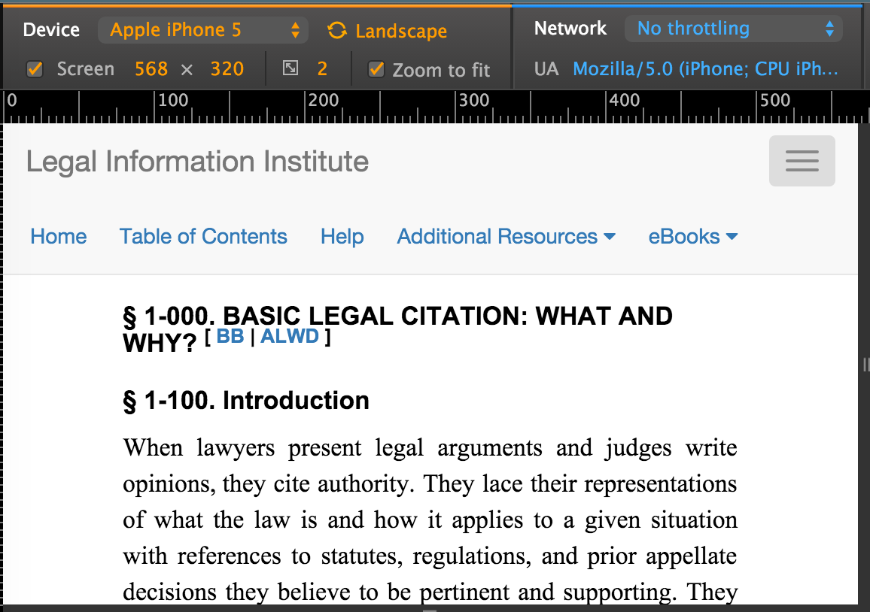
On Apple iPhone 5

Slide 38
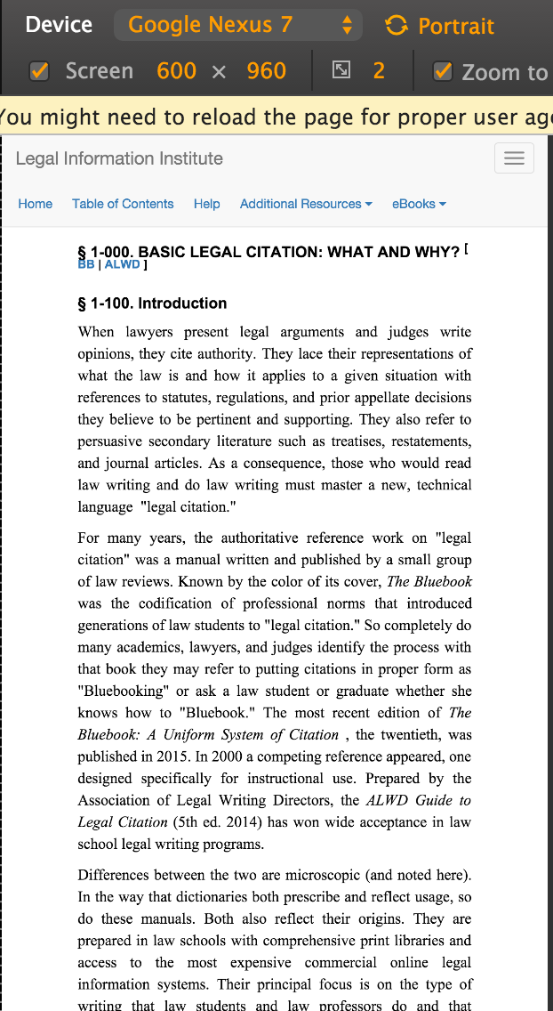
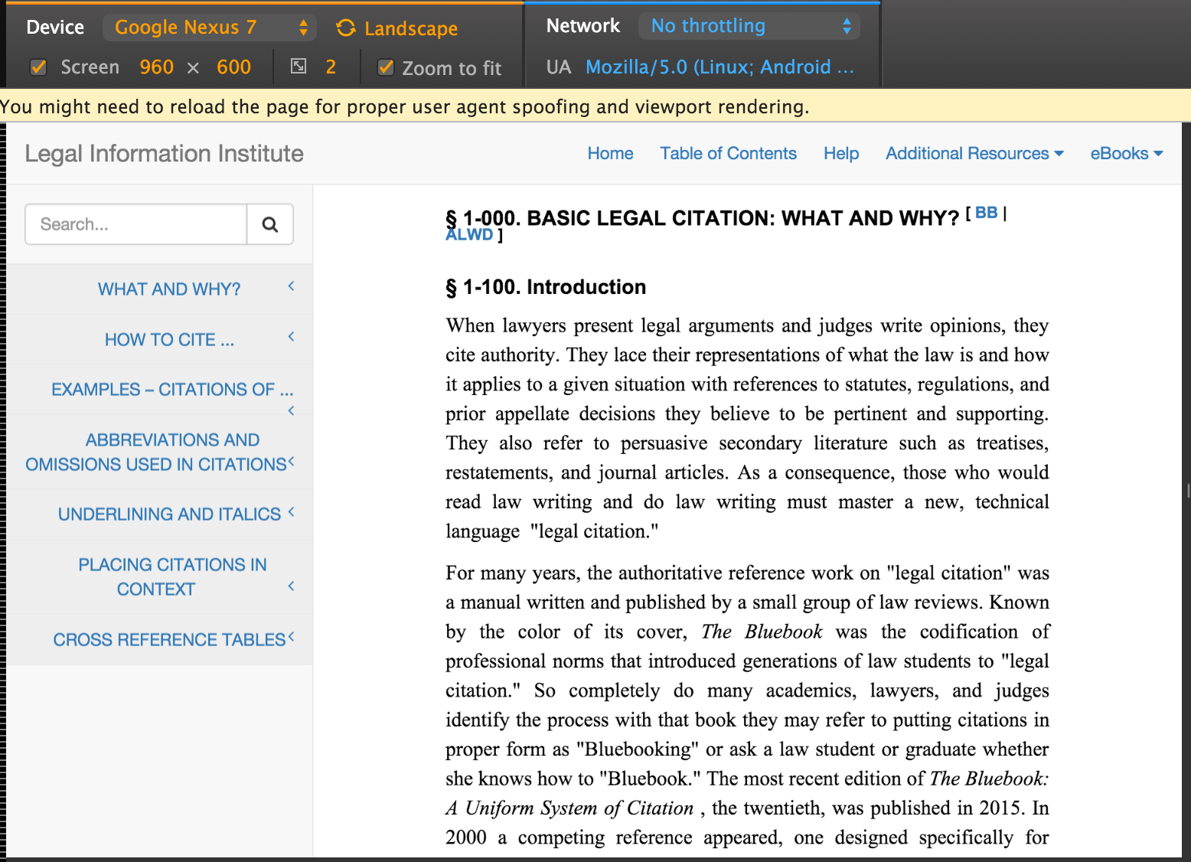
On Samsung Galaxy

Slide 39
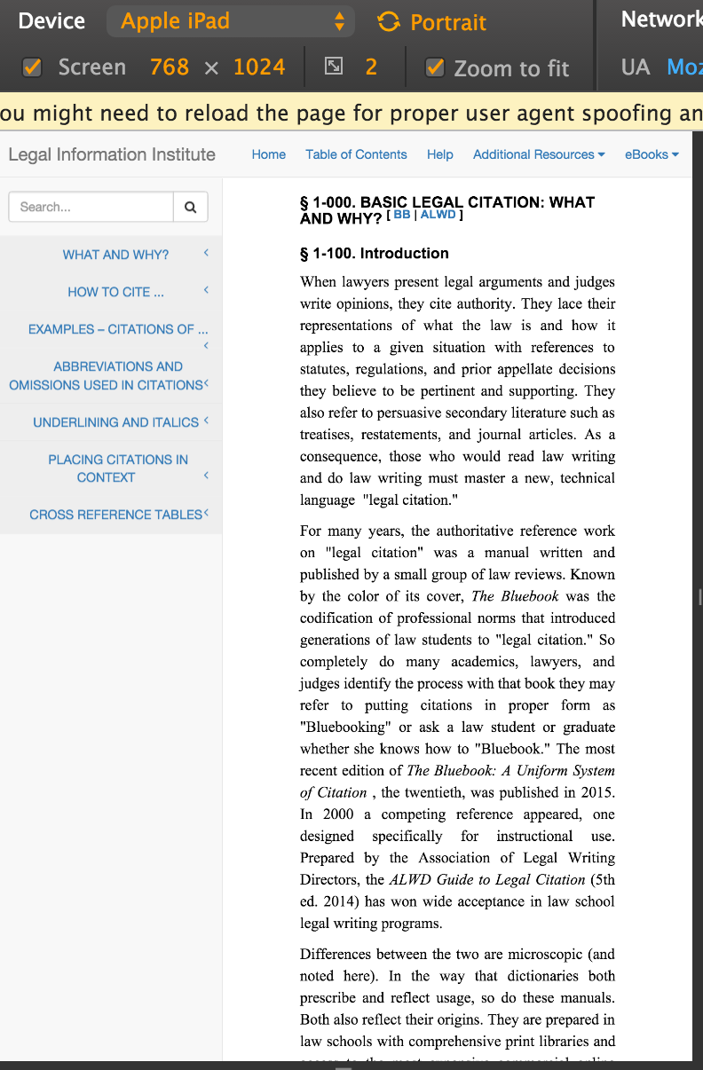
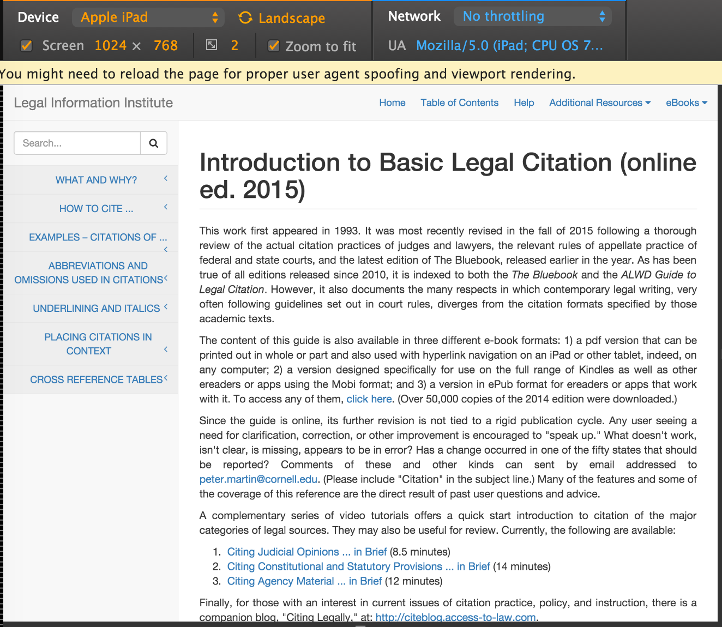
On Apple iPad

Slide 40

Project Summary
Gantt Chart
Achievements and challenges
Pending Tasks
Summary of Deliverables

Slide 41
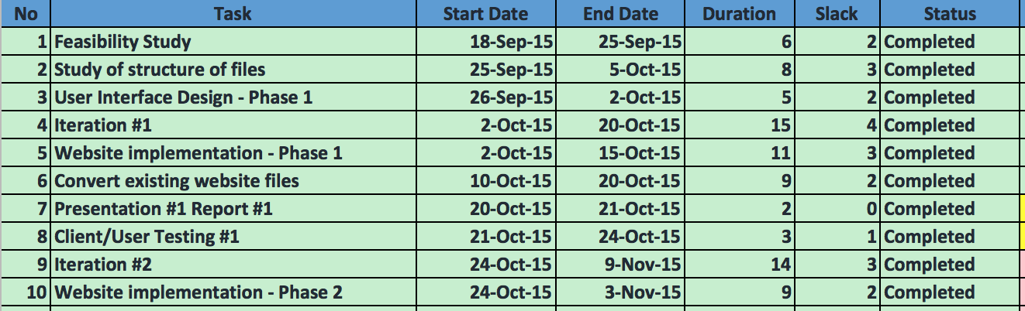
Gantt Table

Slide 42
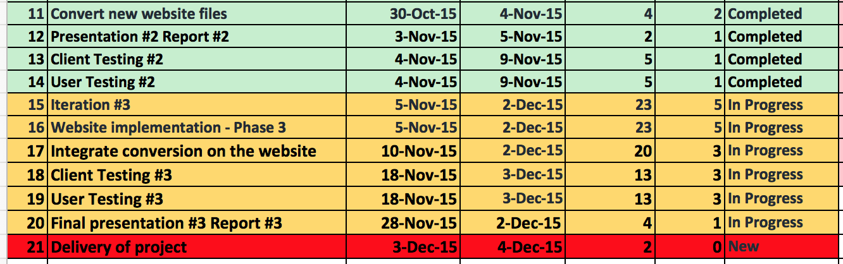
Gantt Table (cont.)

Slide 43
Requirements
Mobile-friendly website
Interactive website
Converter to other formats
Author view to convert file formats
HTML markup tags

Slide 44
Requirements
✔ Mobile-friendly website
Interactive website
Converter to other formats
Author view to convert file formats
HTML markup tags

Slide 45
Requirements
✔ Mobile-friendly website
✔ Interactive website
Converter to other formats
Author view to convert file formats
HTML markup tags

Slide 46
Requirements
✔ Mobile-friendly website
✔ Interactive website
✔ Converter to other formats
Author view to convert file formats
HTML markup tags

Slide 47
Requirements
✔ Mobile-friendly website
✔ Interactive website
✔ Converter to other formats
✔ Author view to convert file formats
HTML markup tags

Slide 48
Requirements
✔ Mobile-friendly website
✔ Interactive website
✔ Converter to other formats
✔ Author view to convert file formats
✔ HTML markup tags

Slide 49
Requirements
✔ Mobile-friendly website
✔ Interactive website
✔ Converter to other formats
✔ Author view to convert file formats
✔ HTML markup tags

Slide 50
Achievements
✔ Mobile-friendly website
✔ Interactive website
✔ Converter to other formats
✔ Author view to convert file formats
✔ HTML markup tags

Slide 51
Challenges/Mistakes
Time constraint due to starting late.
Lack of enough communication with the client at the beginning.
Didn’t include breaks when scheduling tasks.
Nobody in the team with law background, lack of user perspective.
Notes:
some humor

Slide 52
Pending Tasks
Compatibility testing on different screen sizes
Acceptance testing
Project Delivery

Slide 53
Summary of Deliverables
Feasibility study
Requirements analysis and specification
System and program design
User interface design and testing
Test plan, test examples, and results
Source code
An unrestricted license for the client

Slide 54
Q & A
Notes:
Peter:
Might still need tables in static ebooks
Sara:
Interactivty examples: user; author
Metadata search
Table replaced
Not guess, but client experience
Strong progess, capable to finish it
More communications
Slyvia:
More communications. There is something we’ve done that we know not working.
Arms:
Building on an existing system, getting the requirements right is more difficult. Which is the client really want.
A little bit worried about schedule. Time for user testing and making changes
Gantt chart: how to describe the work it’s done. Complete is not complete.
Difficult in userbility and format conversion.
Is converting exsiting html a part of a project. XHTML to HTML.

